Slide 1


DMart Product Sales Analytics
Retail Sector Management Perspective — A strategic framework for converting sales data into competitive advantage, operational excellence, and sustainable growth.

Slide 2

The Strategic Problem Facing Modern Retail
DMart and comparable retailers face compounding pressures that demand structured analytical responses — not intuition alone.
Inconsistent Sales Performance
Profitability Pressure
Portfolio Complexity
Operational Inefficiency
Revenue growth is not translating to margin expansion.
SKU proliferation without strategic prioritization dilutes focus.
Process gaps erode the value captured at the shelf.
Category and regional volatility obscures true demand signals.

Slide 3
FRAMEWORK 01
The 5W Analysis Framework
A structured diagnostic lens for understanding business performance before committing to strategic action.
What
Who
Where
Which products, categories, or services drive the most value?
Who are the highest-value customer segments and key stakeholders?
Where do the strongest growth opportunities and gaps exist?
When
Why
When do peak demand cycles and operational challenges occur?
Why do performance variations exist across categories and regions?

Slide 4
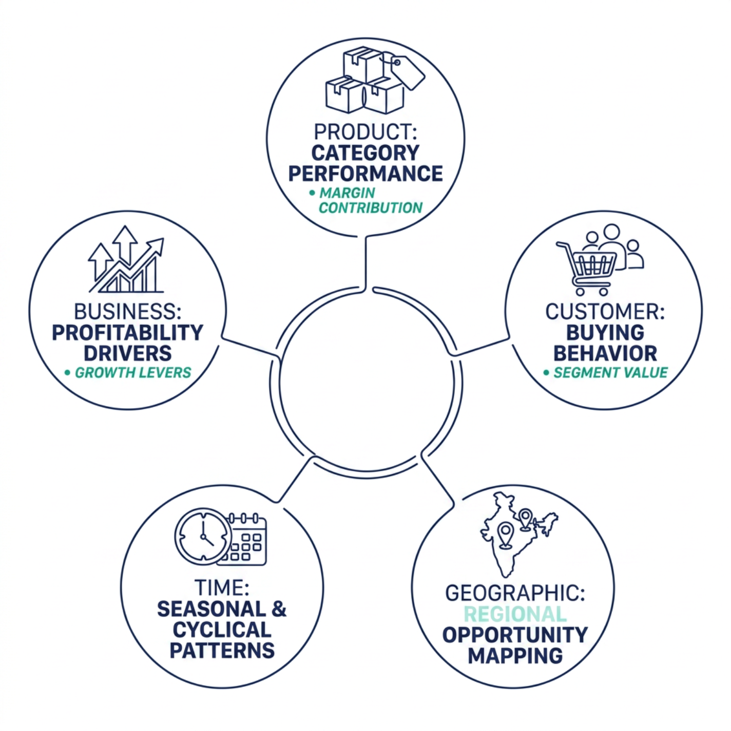
Applying the 5W Framework at DMart
Management Benefit
The 5W framework transforms raw operational data into a multi-dimensional business intelligence view — enabling leadership to diagnose before prescribing.
Category Intelligence
Customer Clarity
Strategic Timing
Rank SKUs by contribution margin, not just revenue.
Map buying patterns to store format and geography.
Align promotions and inventory to demand cycles.

Slide 5

5 Why Analysis: Root Cause Discovery
A disciplined methodology for peeling back layers of symptoms to reveal the fundamental cause of business underperformance.
Why 1
Why 2
Why 3
Why 4
Why 5

Slide 6
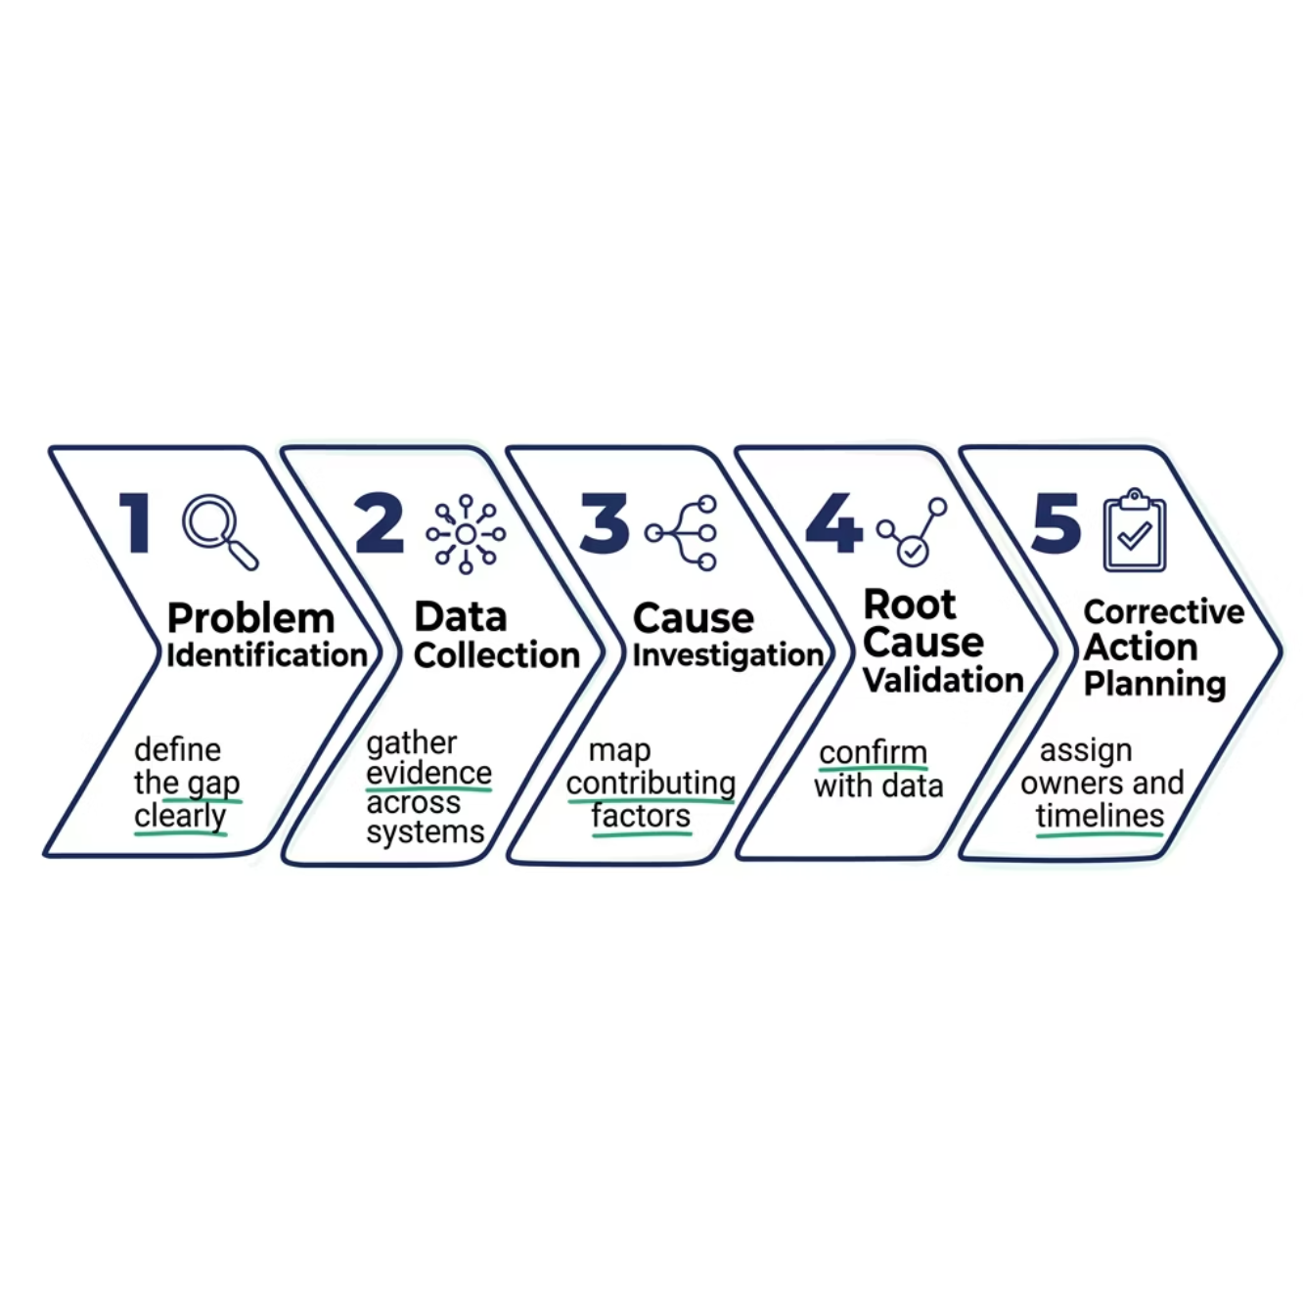
Root Cause Analysis (RCA)
RCA shifts organizations from reactive firefighting to proactive, systemic improvement — reducing recurring operational losses.
Why RCA Matters for DMart
Without structured root cause identification, the same issues resurface — costing margin, morale, and market position.
Better Decisions
Sustainable Fixes
Resource Efficiency
Evidence-based, not assumption-driven.
Eliminate causes, not symptoms.
Invest where impact is highest.

Slide 7
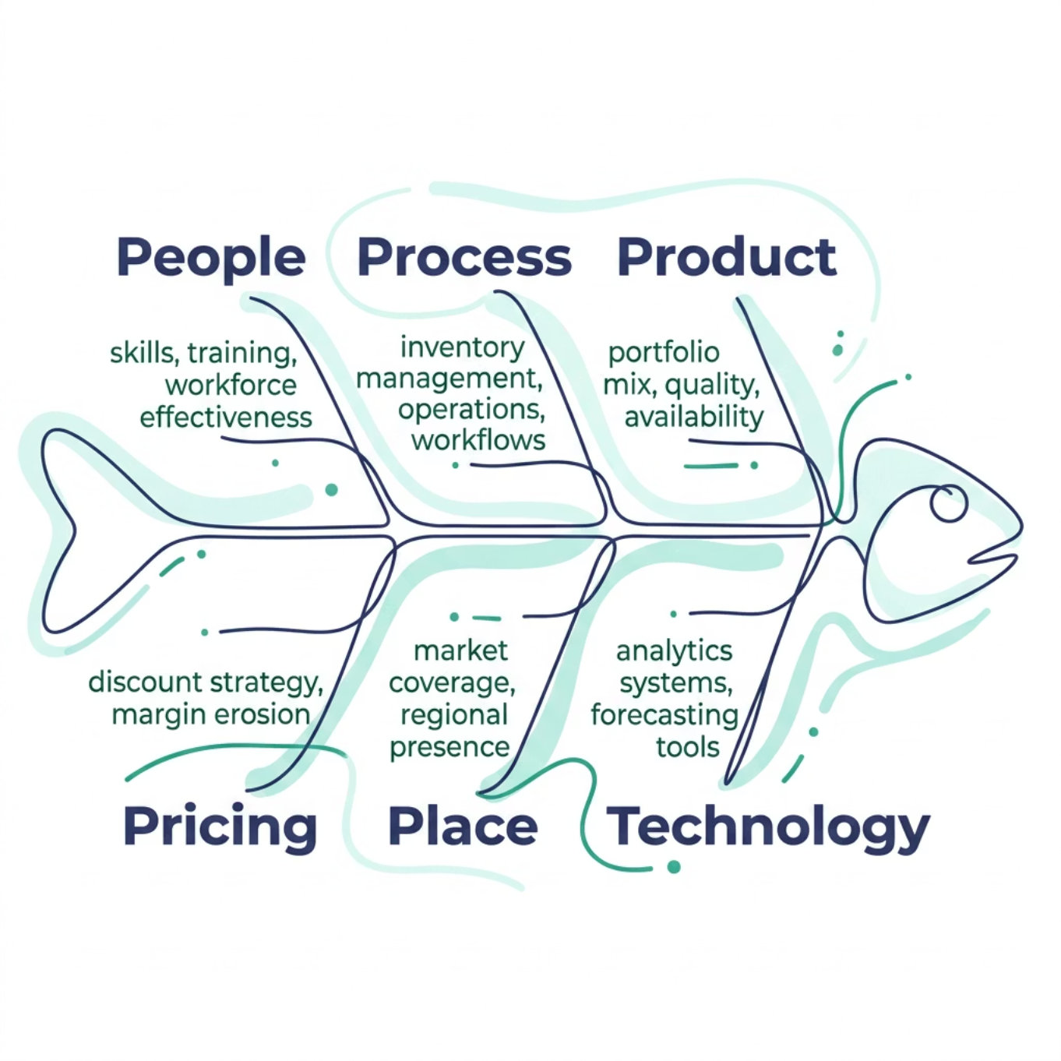
Ishikawa (Fishbone) Diagram
A structured cause-and-effect framework for diagnosing operational challenges across six critical dimensions of retail performance.
Strategic Application
The Fishbone Diagram enables cross-functional teams to systematically categorize and prioritize the drivers of underperformance — turning a complex problem into an actionable improvement roadmap.
Cross-Functional Clarity
Prioritization Logic
Aligns operations, commercial, and technology teams on shared root causes.
Distinguishes high-impact causes from peripheral factors.

Slide 8
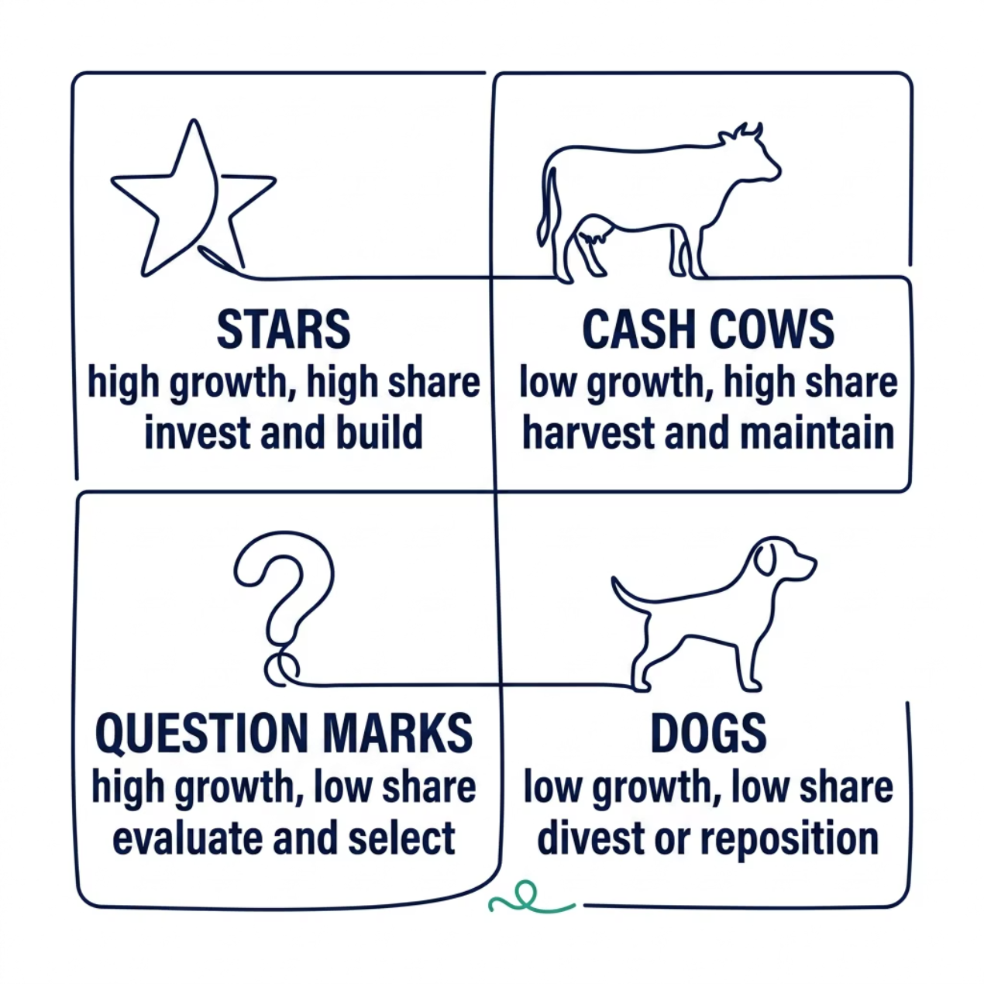
BCG Matrix: Strategic Portfolio Management
Portfolio Strategy for DMart
Not all categories deserve equal investment. The BCG Matrix provides a disciplined lens for capital allocation, category prioritization, and long-term portfolio balance.
Stars
Cash Cows
Question Marks
Dogs
High-growth, high-share categories — protect and invest.
Mature, dominant categories — optimize margins and fund growth.
Emerging opportunities — selectively invest with clear milestones.
Low-growth, low-share — rationalize or reposition.

Slide 9

Key Strategic Insights
Individually powerful — but transformative when combined. These frameworks form an integrated management system for retail excellence.
5W Analysis
Builds comprehensive business understanding before action is taken.
5 Why + RCA
Uncovers hidden root causes and enables durable, systemic solutions.
Fishbone Diagram
Structures cross-functional diagnosis across all operational dimensions.
BCG Matrix
Drives disciplined capital allocation and category portfolio decisions.

Slide 10

Strategic Recommendations & Conclusion
01
KPI-Driven Governance
Embed analytics into every management review cycle.
02
Value Over Volume
Shift category strategy from revenue to margin optimization.
03
Framework Discipline
Apply 5W, RCA, and BCG in quarterly strategic planning.
04
Portfolio Rationalization
Reassess category roles using the BCG Matrix annually.

